Slide 1
Women Rectors across Europe Conference
15-17 May 2014, Istanbul
Beyond the Glass Ceiling:
Changing the Outlook in Science
Dr Judith Kinnear
Former Vice-Chancellor
Massey University, New Zealand

Slide 2
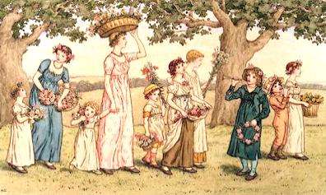
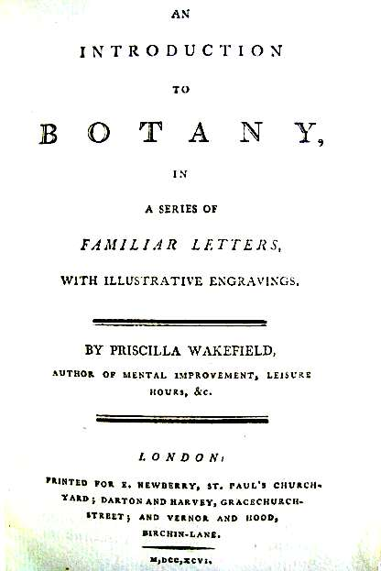
‘ May {the book} become a substitute for some of the trifling, not to say pernicious, objects that too frequently occupy the leisure of young ladies of fashionable manners, and,
by employing their faculties rationally,
act as an antidote to levity and idleness.
‘Botany . . . contributes to the health of body and cheerfulness of disposition, by presenting an inducement to take air and exercise.’
Notes:
Wakefield, Priscilla (1796). An Introduction to Botany in a Series of Familiar Letters. Preface.
Phelps, Amelia (1829) Familiar letters on Botany. Introduction

Slide 3
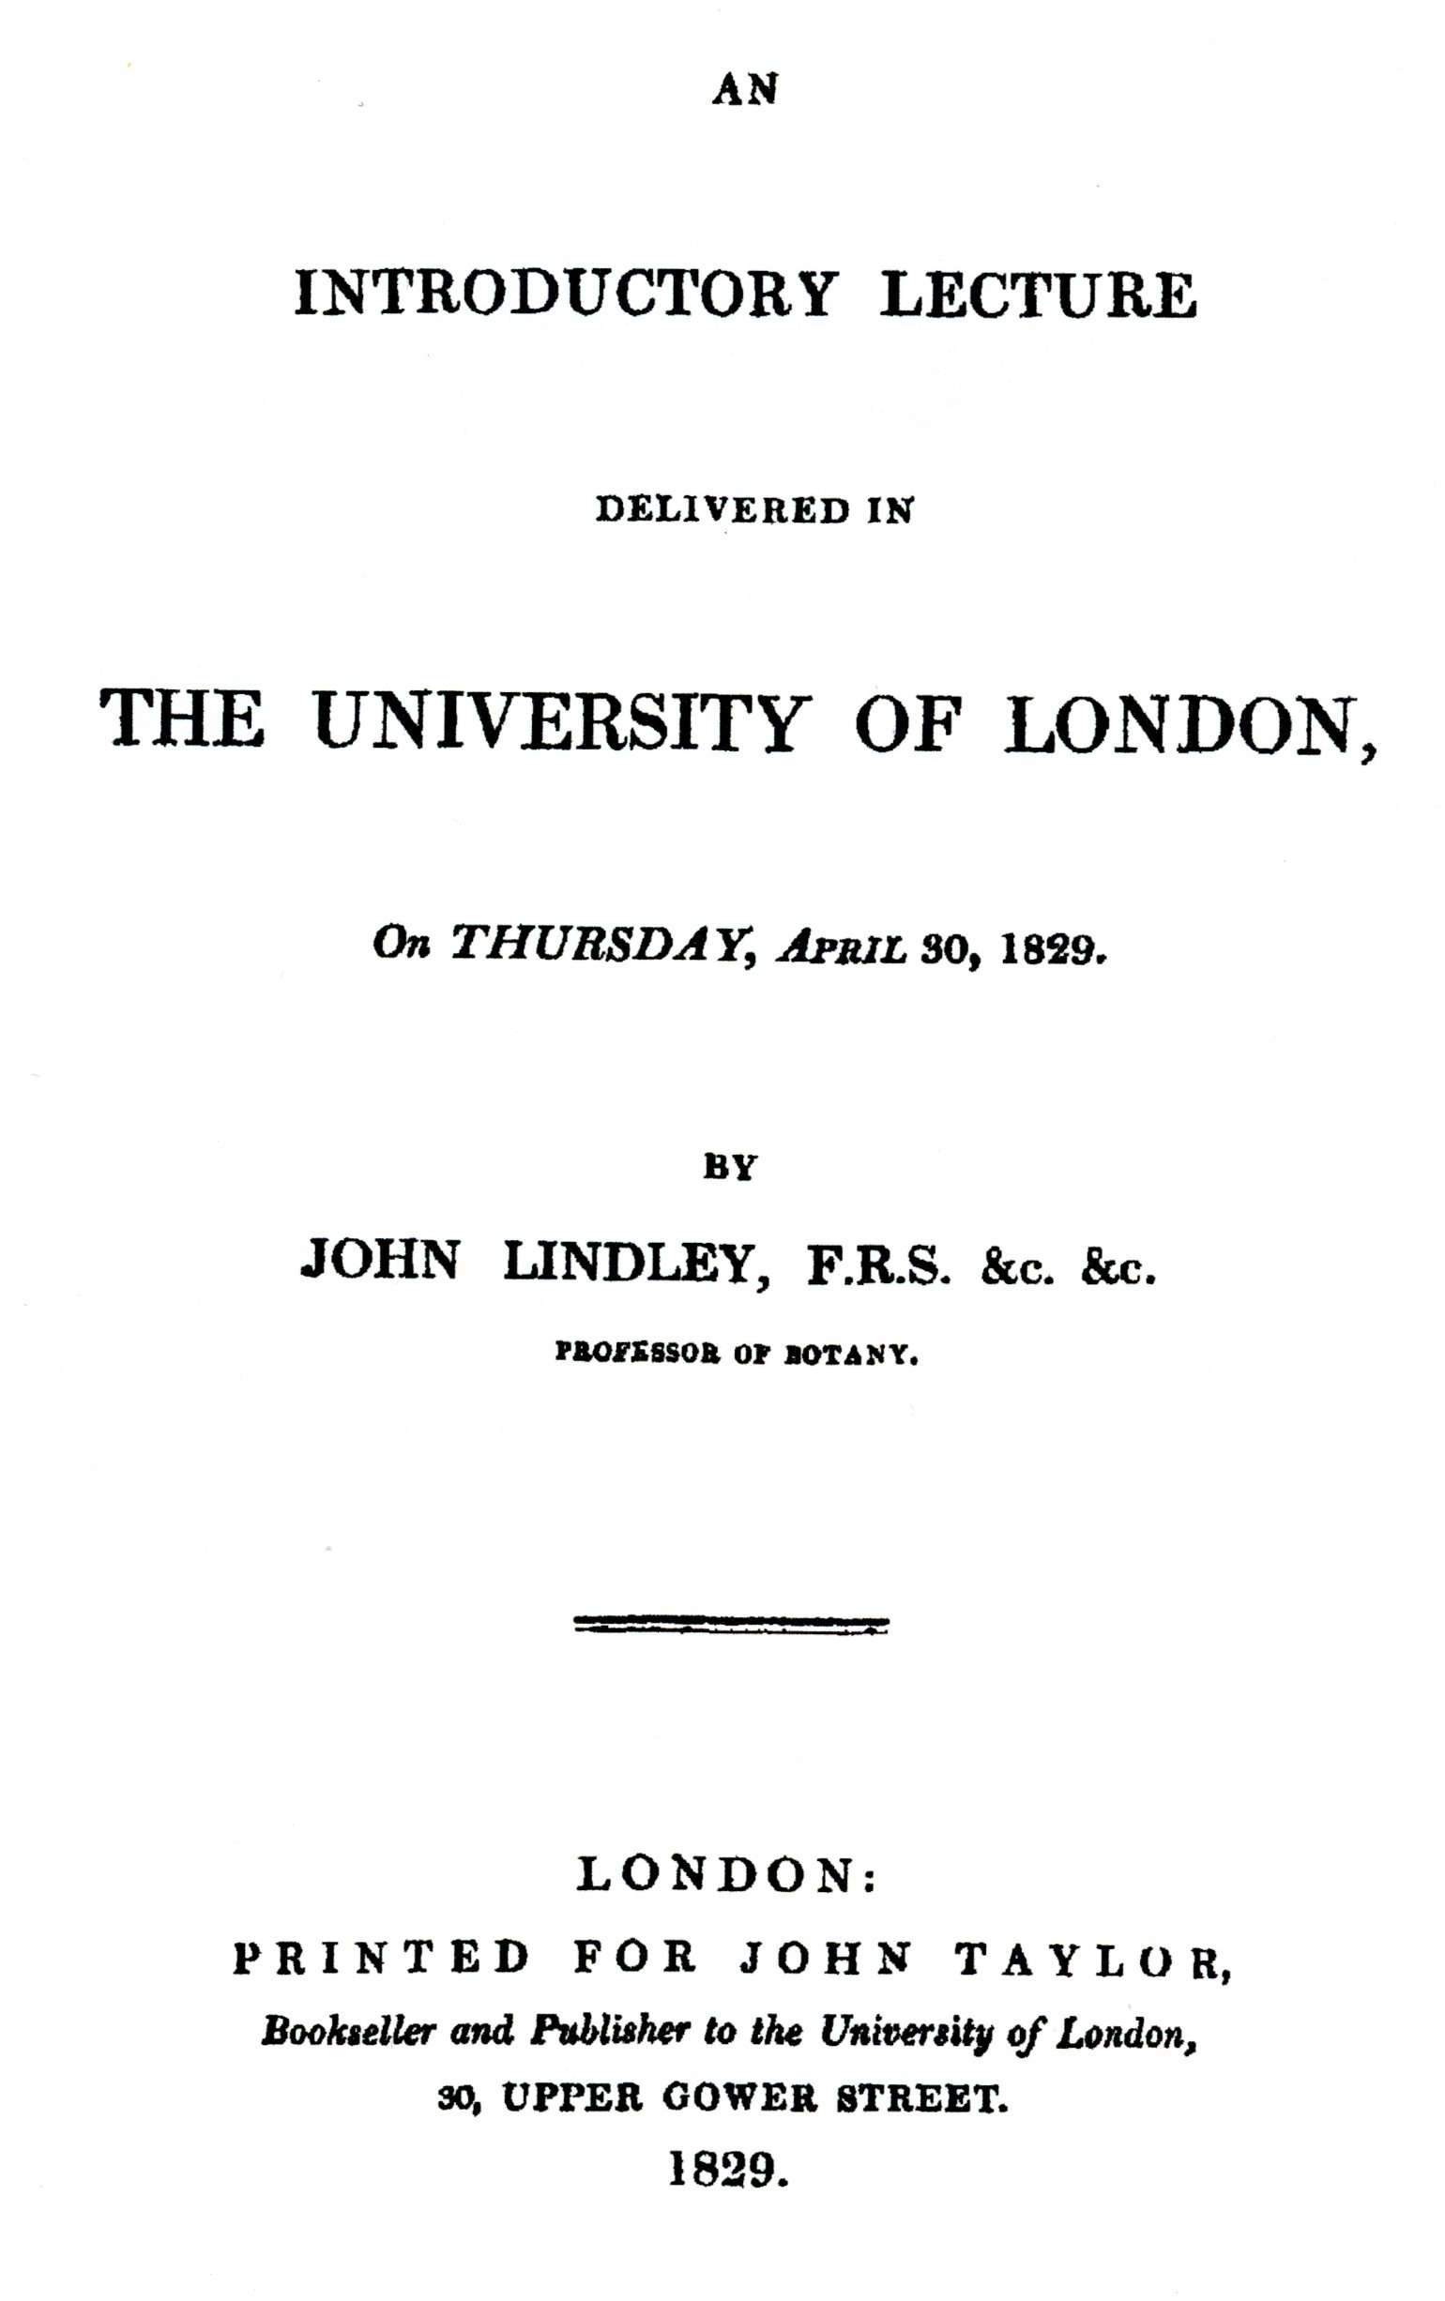
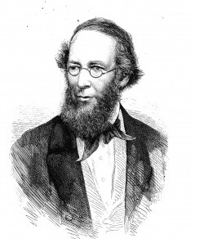
John Lindley (1799-1865):
First Professor of Botany at the University of London.
Inaugural lecture: 30 April, 1829.
Notes:
Image from: John Lindley, Professor of Botany, from Gardener's Monthly magazine 1867
Source: http://www.blogcatalog.com/blogs/american-gardening

Slide 4
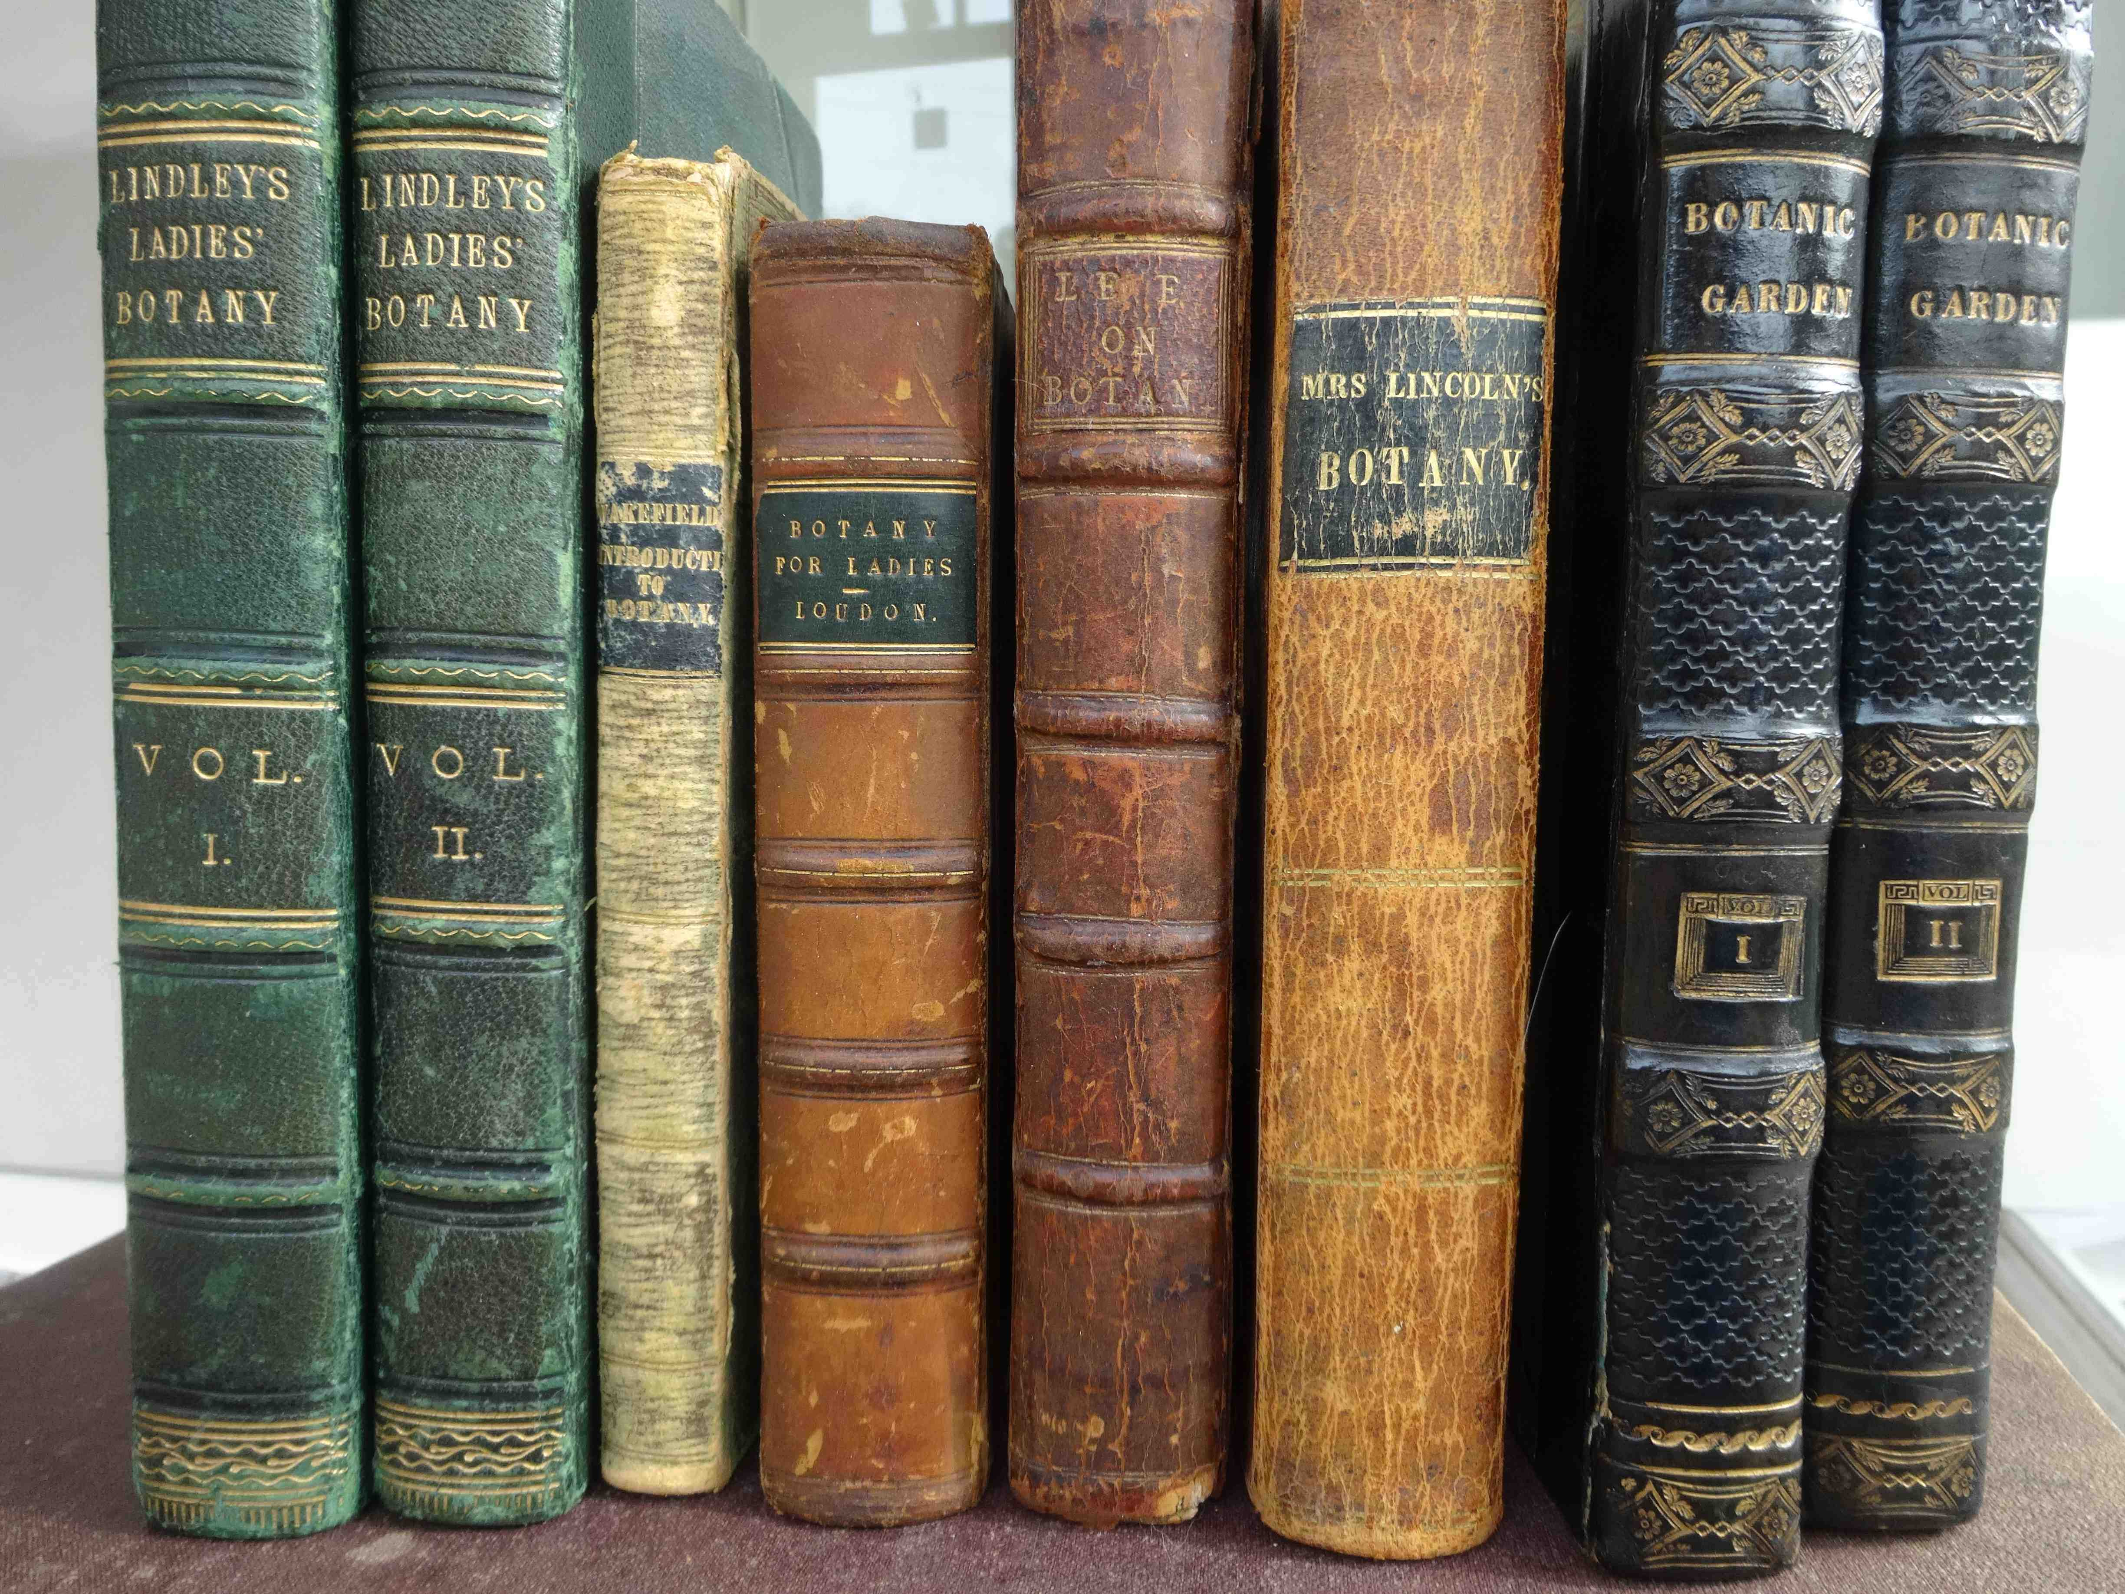
Lindley’s reform of Botany
The question is “… whether we cannot redeem one of the most interesting departments of Natural History [Botany] from the obloquy which has become attached to it in this country . . .
“ It has been very much the fashion of late years, in this country, to undervalue the importance of this science, and to consider it
an amusement for ladies
rather than
an occupation for the serious thoughts of man.”
Source: Lindley’s Intro lecture: pp14 and 17
Notes:
Obloquy = strong public condemnation; Disgrace, especially that brought about by public condemnation; vilification, opprobrium, vituperation.
Source: Lindley’s Introductory lecture, pp 14, 17.

Slide 5
Gender Partitioning of Botany
For WOMEN:
Botany: A ladylike, pious and amateur pastime with moral and social overtones, involving:
collecting plants
cultivating plants
identifying and classifying plants
drawing/painting plants
educating children about plants - as part of good motherhood
writing stories about plants
For MEN:
Botany: A professional and scientific discipline, specialist not generalist, involving:
making observation
testing hypotheses
formulating laws
applying principles in practical situations
forming and participating
in meetings of learned societies

Slide 6
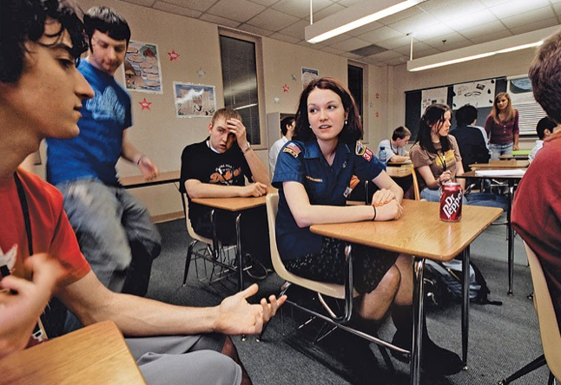

25 November, 2013
Degrees of separation: more women enrolling at universities
More women are enrolling at university than before, and outnumber men from bachelor degrees to the top doctoral peaks.
Girls outperform and outstay boys in school and, as a result, they go on to university in ever greater numbers.
By 2012, graduation numbers had increased to nearly 195,000, of whom 60 per cent were female. . . .
Source: www.smh.com.au
Notes:
Source: www.smh.com.au/national/education/degrees-of-separation-more-women-enrolling-at-universities-20131124-2y46e.html#ixzz2zUSLxuaE

Slide 7
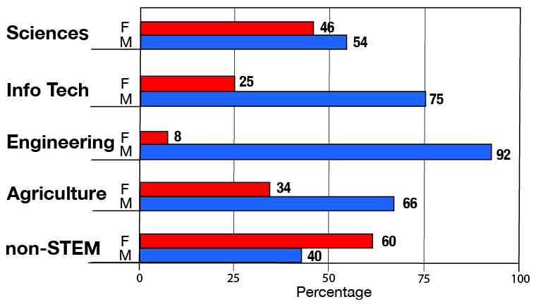
STEM-qualified population by sex and broad field
Source: ABS 4250.0.55.005, 24 Feb 2014
Notes:
STEM: Science, Technology, Engineering & Mathematics
Source: ABS Survey of Learning & Work 2010-11. Publication: 4250.0.55.005- Perspectives on Education and Training. Released 24 Feb 2014.
Available at: http://www.abs.gov.au/ausstats/abs@.nsf/Lookup/by%20Subject/4250.0.55.005~2010%E2%80%9311~Main%20Features~Demographic%20characteristics~5

Slide 8
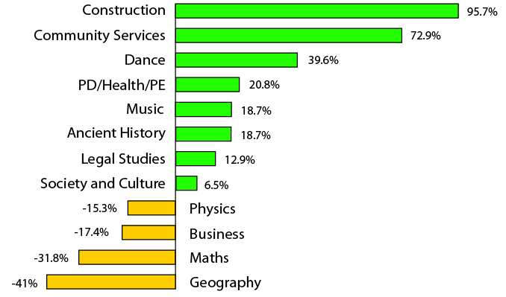
Changes in subject choices by HSC students
from 2003 to 2013 (adjusted for population growth)
Source: Redrawn from SMH 5 Oct 2013
Notes:
Source: www.smh.com.au/national/education/geography-loses-as-hsc-students-map-their-futures-20131004-2uzpq.htmll
SMH 05Oct 2013. Community Services = Community and Family Studies.
PD/Health/PE = Personal Development, Health and Physical Education.
HSC comprises Board Developed Courses (BDC), Board Endorsed courses (school developed); also VET courses, 10 of which are BDCs and give credit for HSC.

Slide 9
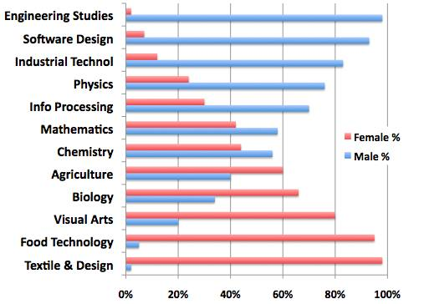
Gender-bias in HSC subject choice (2013) by
high-achieving NSW students
Source: NSW Board of Studies, 2013
Notes:
Available at: www.smh.com.au/national/education/hsc-trends-hark-back-to-gender-stereotypes-of-50s-20131219-2znf1.html
Data source: NSW Board of Studies, 2013

Slide 10
14 October 2013
HSC Reflects Gender Gap among Australians
Enrolment figures for the 2013 HSC exam showed a broader gender gap among young Australians.
Girls have the tendency to shun off physics, math and engineering because there can only be "jobs for boys" after graduation.

Slide 11

14 December 2011
Gender numbers in VCE maths just don’t add up
VCE math is failing the gender test, with the number of boys enrolled in the most difficult subject - specialist math - double that of girls.
A study of year 12 students from 10 secondary schools found girls studying math subjects were much less likely than boys to perceive them as relevant and useful for their future.
Notes:
Melbourne Age: 14 Dec 2011

Slide 12

Sydney, 14 October 2013
Gender gap widens for some HSC subject
Enrolment figures for this year’s HSC reveal the gender gap is widening in subjects such as physics in which boys make up nearly four in five of the pupils about to sit the course.
A lack of confidence could be stopping girls from taking their place in male-dominated high school subjects, further feeding stereotypes that some careers such as engineering are "jobs for boys” . . . . reinforced by a lack of female role models.
Notes:
Source: Telegraph 14 October 2013
Available at: http://www.dailytelegraph.com.au/news/nsw/gender-gap-widens-for-some-hsc-subjects-but-students-buck-trend/story-fni0cx12-1226739250697

Slide 13
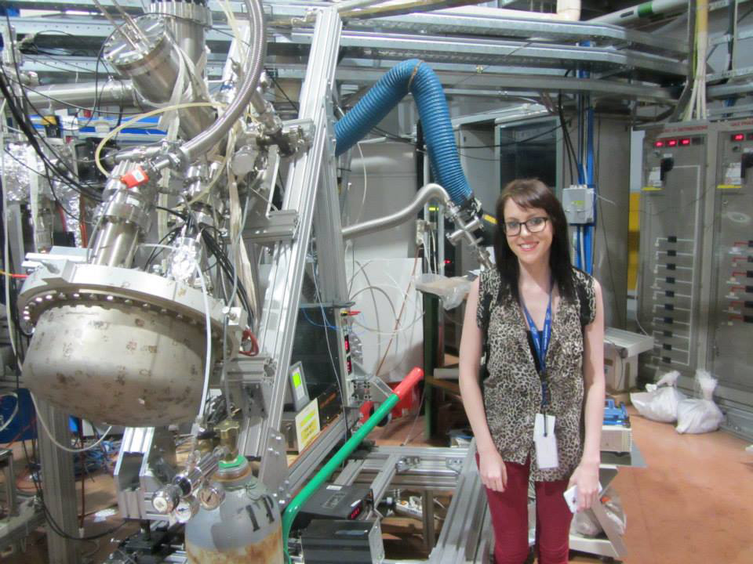
Student role model
Rebecca Auchetti, Honours student, computational and theoretical chemistry,
Swinburne University of Technology
at the Elettra Sincrotrone, Trieste
Source: Swinburne University of Technology
Notes:
Elettra 2013 - Rebecca Auchettl in front of the XPS Analyzer.jpg
SUT’s first honours student to travel to the Elettra Sincrotrone in Trieste, Italy, where she researched her computational and theoretical chemistry project.

Slide 14
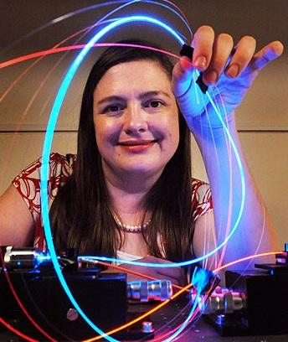
Role model
Professor Tanya Monro, physicist,
Director, ARC Centre of Excellence for Nanoscale BioPhotonics
Source: The University of Adelaide. Picture: BRENTON EDWARDS Source: The Advertiser
Notes:
Source: The University of Adelaide.
Picture: BRENTON EDWARDS Source: The Advertiser

Slide 15
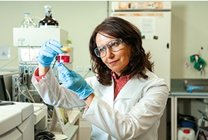
Role model
Professor Fariba Dehghani
chemical engineer, U Sydney
researching the processing of biomaterials,
with applications in tissue engineering
and regenerative medicine
Source: http://sydney.edu.au/alumni/sam/march2014/fariba-dehghani.shtml
Notes:
Source: http://sydney.edu.au/alumni/sam/march2014/fariba-dehghani.shtml

Slide 16

10
1
2
1 Sciences (10%)
2 Info. Tech (2%)
3 Engineering (5%)
4 Architecture (2%)
5 Agriculture (<2%)
6 Health (17%)
7 Education (9%)
8 Business (19%)
9 Humanities (24%)
10 Creative Arts (10%)
3
9
4
5
6
8
7
UG completions in broad fields of education
Notes:
Source: Data from Table 1 www.spre.com.au/download/SPREGenderAgenda2012.pdf
Fields of Education: broad, narrow & detailed from: http://www.abs.gov.au/ausstats/abs@.nsf/0/E7779A9FD5C8D846CA256AAF001FCA5C?opendocument

Slide 17
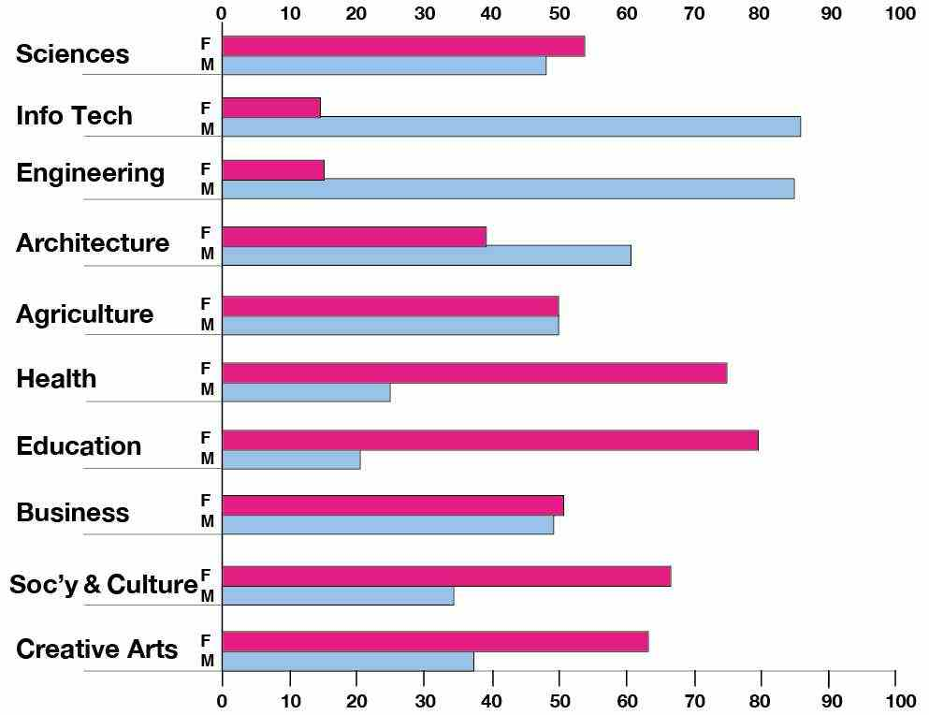
UG completions in broad fields of study by gender
Notes:
Source: Data from Gender Agenda Table A. http://www.spre.com.au/download/SPREGenderAgenda2012.pdf
Fields of Education: broad, narrow & detailed from: http://www.abs.gov.au/ausstats/abs@.nsf/0/E7779A9FD5C8D846CA256AAF001FCA5C?opendocument

Slide 18
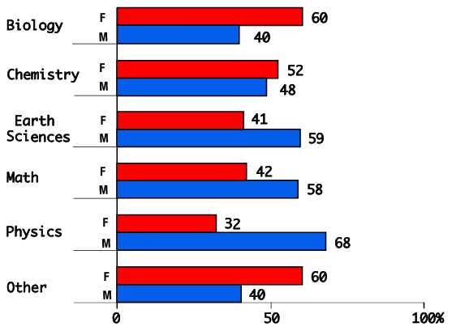
UG student load in narrow fields of science
by gender
Source: Chief Scientists Report: table 4.15
Notes:
UG Gender distribution across narrow field of Science. Other includes Forensic, Pharmacology, Food Technology inter alia
Source: Chief Scientists Report, Table 4.15 for 2009.
Available at: www.chiefscientist.gov.au/wp-content/uploads/Unhealthy-Science-Report-Ian-R-Dobson.pdf

Slide 19
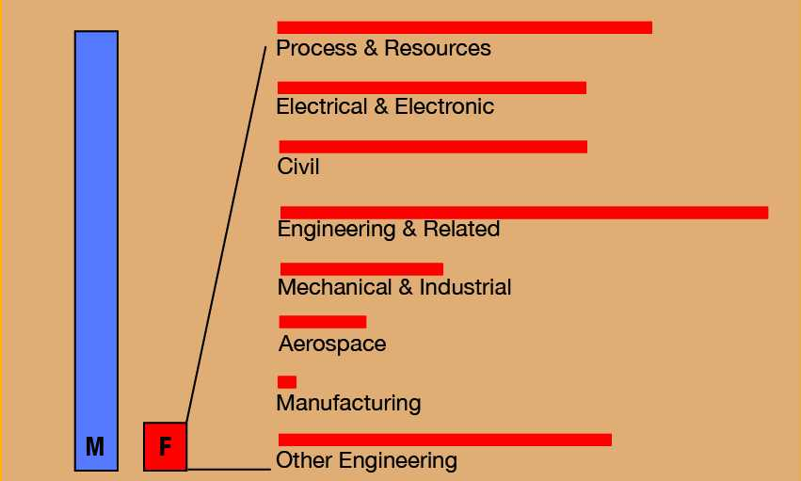
Female enrolments in narrow fields of Engineering
Source: Data from figure 1 Nguyen & Pudlowski
Notes:
Australia-wide Engineering enrolments, with females at 15%
‘Other’ includes inter alia Environmental, Biomedical, Fire Technology, also {Maritime, Geomatic, Automotive}.
Source: Data extracted from figure 1 Ngiyen & Pudlowski
Available as pdf file at: http://www.wiete.com.au/conferences/3wiete/Pages/05-Nguyen-D.pdf

Slide 20

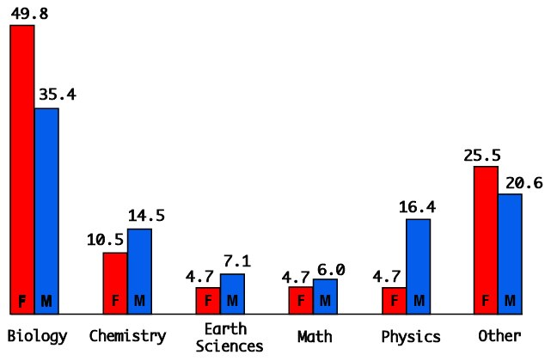
PhD completions % in narrow fields of science
by gender
Source: Chief Scientists Report: table 4.31
Notes:
Source: Source: Chief Scientists Report, Table 4.31 for 2009.
Available at: http://www.chiefscientist.gov.au/wp-content/uploads/Unhealthy-Science-Report-Ian-R-Dobson.pdf

Slide 21
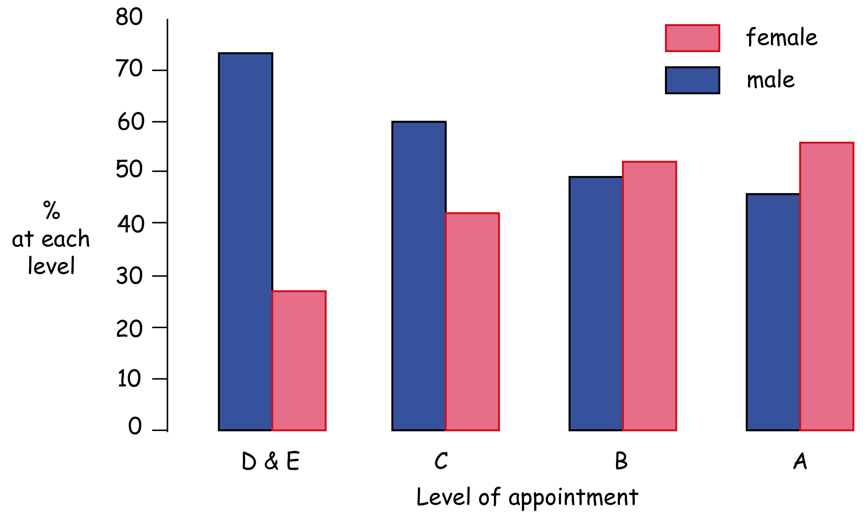
D/E: Prof/AssocProf C: Senior Lecturer B: Lecturer A: Tutor
Gender distribution by level of academic appointment:
. . . an example of vertical segregation

Slide 22
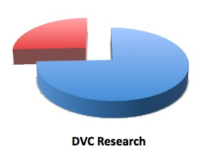
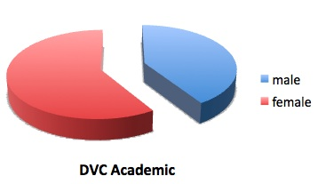
Gender distribution at DVC (Vice-Rector) level
. . . an example of horizontal segregation?
Data as at May 2014 from Universities Australia website
Notes:
Gender distribution: DVC research males 29: females 10 Compare DVC academic males 16; females 23
Data as at May 2014
Source of data: www.universitiesaustralia.edu.au/australias-universities/university-key-contacts#.U2zpMcfSrww

Slide 23
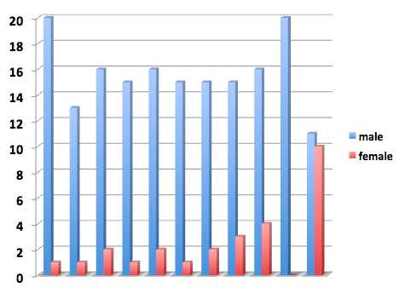

2004
2014
Elected Fellows of Australian Academy of Science by gender for the period 2004 to 2014
Data from AAS website
Notes:
AAS established in 1954, elected its first female Fellow in 19xx
Percentage of females: 2004-2014 = 15%, but without 2014, figure is 9% for 2004 to 2013

Slide 24
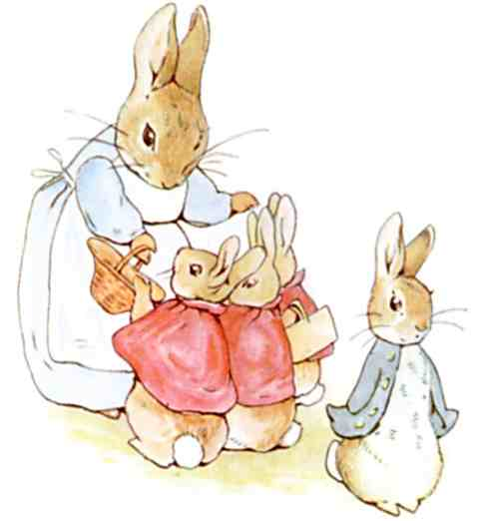
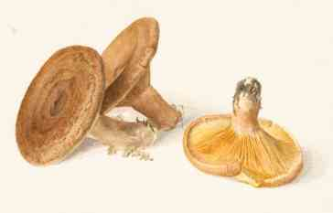
Women in Learned Societies
. . . at least not until 1905
Beatrix Potter (1866-1943):
• famous artist and author of children’s books
• keen observer and student of fungi
• author of scientific paper on germination
of the spores of Agaricineae
In 1897, Potter’s paper was presented at a meeting of the Linnean Society in London on her behalf by a man. As a women, Beatrix Potter was not allowed to present this paper herself, nor could she
even attend the meeting
Notes:
Source of image: Gutenberg ebook of The Tale of Peter Rabbit
Source of Fungus image: www.winsornewton.com/news/beatrix-potter-watercolourist-and-scientific-Illustrator

Slide 25
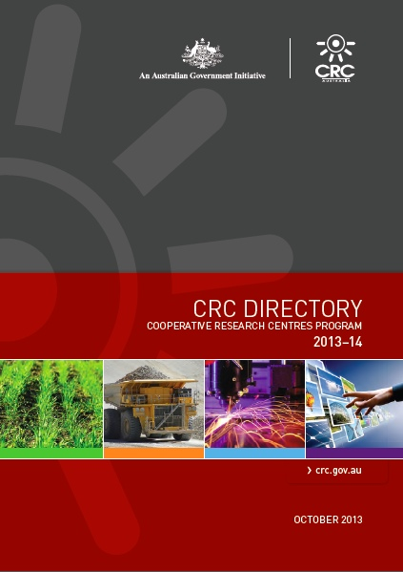
Cooperative Research Centres (CRCs)
CRCs: A national system that supports medium to long-term
collaboration between producers and end-users of research.
40 CRCs operate in four broad domains:
No. of female CEOs
Mining: 0 / 3
Manufacturing: 0 / 4
Agric., Forestry
& Fishing: 0 / 8
Services: 6 / 25
Source: www.crc.gov.au/About-CRCs/Directory/Documents/CRC-Program-CRC-Directory-2013-14.pdf
Notes:
Source : www.crc.gov.au/About-CRCs/Directory/Documents/CRC-Program-CRC-Directory-2013-14.pdf

Slide 26
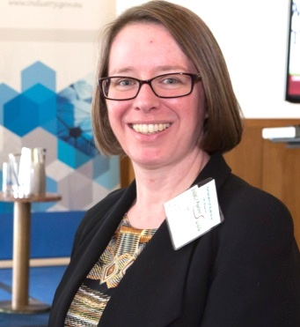
Role model
Professor Valerie Linton, metallurgist
currently
Director, Energy Pipelines Cooperative Research Centre (CRC)
Source: www.epcrc.com.au/ceos-update-february-2014
Notes:
Source: www.epcrc.com.au/ceos-update-february-2014;
CRC info: www.epcrc.com.au

Slide 27

The Business Domain:
How many women leaders?
CEOs: Less than four in every 100 ASX 200
and ASX 500 companies have women CEOs.
Board Chairs: Just 3% of ASX200 companies
have a woman Chair
Directors: 12.3% of ASX200 directorships
are held by women
KMPs: Less than one in 10 executive key management positions in the ASX 200
and the ASX 500 are held by women.
Notes:
Source:
Cf: Of the 500 largest companies in the United States as compiled by FORTUNE magazine, only 23 women are CEOs, and 17% of seats on the board of directors are held by women.

Slide 28
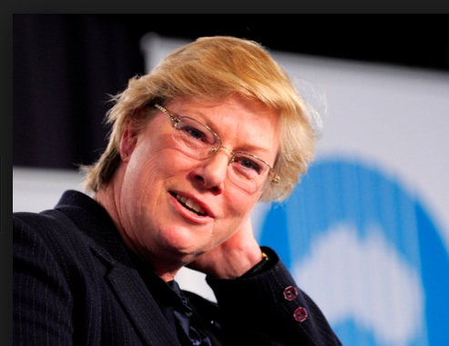
Role model
Dr Megan Clark,
geologist
Chief Executive Officer,
of CSIRO,
Australia’s national research agency
No. of staff: approx. 6500
Annual budget: A$1.3 billion
Source: http://theconversation.com/efficiency-tax-will-stifle-scientific-work-at-csiro-6928
Notes:
Source: http://www.csiro.au/Portals/About-CSIRO/Who-we-are/Executive/MeganClark.aspx
Also: http://theconversation.com/efficiency-tax-will-stifle-scientific-work-at-csiro-6928

Slide 29
Increasing the numbers at senior high school
Programs for female high school students include:
CSIRO’s Scientists and Mathematicians in Schools program
UTS Sydney Women in Engineering and Information Technology program
RMIT Experience Engineering Days & Experience Science Days
Purposes include:
to highlight the range and scope of science and technology
and its relevance to daily life
to publicise study and career options for students
to expose students to role models and challenge stereotypes
Notes:
IMB: Institute of

Slide 30
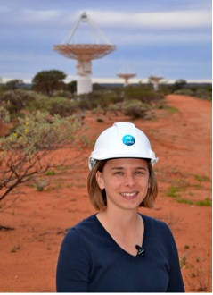
Role model
Dr Lisa Harvey-Smith,
astronomer
Project Scientist for the Australian Square Kilometre Array Pathfinder (ASKAP)
CSIRO Scientist in Schools representative at
Leichhardt Public School
Source: www.atnf.csiro.au/people/Lisa.Harvey-Smith/index.html
Notes:
Source: http://www.atnf.csiro.au/people/Lisa.Harvey-Smith/index.html
Source: www.atnf.csiro.au/people/Lisa.Harvey-Smith/index.html
Also: http://www.lisaharveysmith.com/Home.html

Slide 31
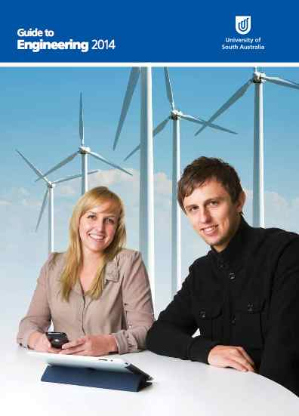
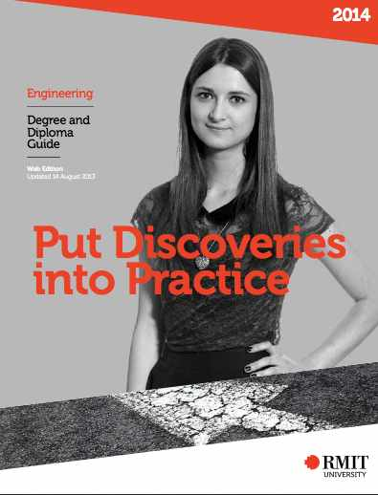

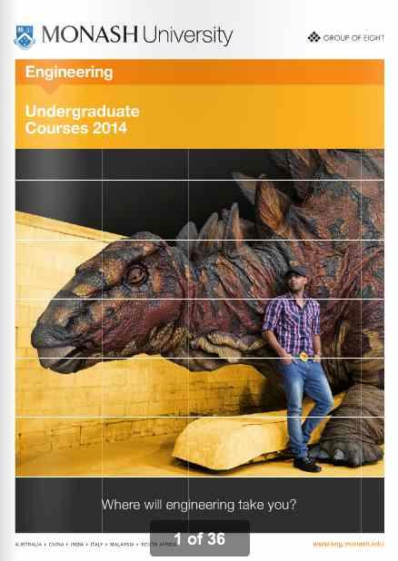
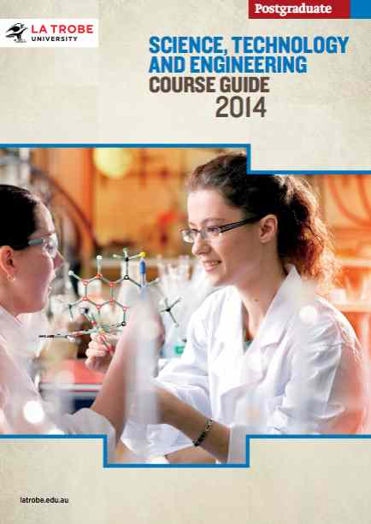
Notes:
SOURCE: RMIT: http://www2.rmit.edu.au/Courses/pdf/eng.pdf
Latrobe: www.latrobe.edu.au/postgrad/downloads/PG-sci-tech-eng-guide-2014.pdf
Monash: http://eng.monash.edu.au/prospective/ug/course-guide.html
USA: www.unisa.edu.au/Global/ITEE/ITEE/DISCIPLINES/Engineering.pdf
UTAS: http://www.utas.edu.au/__data/assets/pdf_file/0010/99892/Computing_Info_systems_at_UTAS.pdf

Slide 32
Retaining female UG students in STEM
Support programs for UG female students in Physical Sciences & Engineering include:
SUWIT Women in Engineering Society at Sydney U
WISE Women in Science and Engineering at Melbourne U
WIT Women in Innovation & Technology at Adelaide U
Purposes include:
to providing opportunities for networking & mentoring
to facilitate links between students and professionals from relevant industries
to promote women in science and engineering to other students

Slide 33
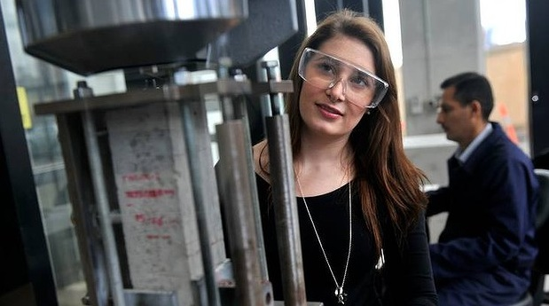
Student role model
Katie York
UG Student in Mechanical Engineering
- one of five women among 119 men
Swinburne University of Technology
Photo credit: Joe Armao
Notes:
Katie York, UG student at Swinburne University of Technology, Melbourne, Australia.
Almost a rarity in Australian higher education - one of the women who make up 16 per cent of the students enrolled nation wide
http://www.smh.com.au/national/education/a-new-take-on-the-gender-gap-20120716-2262p.html
Photo credit: Joe Armao

Slide 34

A need for cultural change?
Letter to the Editor: Time March 10, 2014
“. . . . Grossman names the MALE physicists, calls
them “highly influential” and “internationally respected”.
Meanwhile the unnamed FEMALE physicist is described as holding a ‘bake-off’ between quantum and classical computers.
There has been much gnashing of teeth over why the number of women choosing physics at university has flatlined at 20% despite strenuous attempts by U.K. universities to boost numbers. Perhaps the answer lies with every-day sexism, of which this is another example.”
Notes:
Letter to Editor: Time magazine March 10, 2014

Slide 35
Changing the culture in the workplace
Measures introduced at WEHI include:
technical support for women on maternity leave
Assistance for childcare
allowing additional time for contract renewal
support for meetings and travel
flexible working hours and family-friendly meeting times
Purposes:
• to stop the loss of women staff in mid-career and encourage highly qualified women to return after maternity leave
• to remove gender-specific barriers to promotion
• to assist transition of women to independent researchers and leaders in their field

Slide 36

An open and inclusive organisational culture
• Increasing the numbers of female students studying science and technology at high school and at university is a worthwhile goal, but this alone will not achieve gender equity.
Notes:
Example of Monash VC: Co-Chair of the of the Equal Opportunity for Women Committee
that produced the Social Inclusion Gender Equity Strategy 2011-2015

Slide 37
Achieving an open and inclusive culture
• Increasing the numbers of female students studying science and technology at high school and at university is a worthwhile goal, but this alone will not achieve gender equity.
• Women graduates in science and technology are being lost in mid-career from universities and research institutions, often because of a male-oriented organisational culture that disadvantages women.
Notes:
Example of Monash VC: Co-Chair of the of the Equal Opportunity for Women Committee
that produced the Social Inclusion Gender Equity Strategy 2011-2015

Slide 38
An open and inclusive organisational culture
• Increasing the numbers of female students studying science and technology at high school and at university is a worthwhile goal, but this alone will not achieve gender equity.
• Women graduates in science and technology are being lost in mid-career from universities and research institutions, often because of a male-oriented organisational culture that disadvantages women.
• Gender equity must be embedded in the practices and processes of an organisation - e.g. promotion criteria, workloads, mentorship of junior staff - and be reflected in the attitudes of its managers.
Notes:
Example of Monash VC: Co-Chair of the of the Equal Opportunity for Women Committee
that produced the Social Inclusion Gender Equity Strategy 2011-2015

Slide 39
An open and inclusive organisational culture
• Increasing the numbers of female students studying science and technology at high school and at university is a worthwhile goal, but this alone will not achieve gender equity.
• Women graduates in science and technology are being lost in mid-career from universities and research institutions, often because of a male-oriented organisational culture that disadvantages women.
• Gender equity must be embedded in the practices and processes of an organisation - e.g. promotion criteria, workloads, mentorship of junior staff - and be reflected in the attitudes of its managers.
• Leadership at the highest level can shape organisational culture by ensuring that equal opportunity principles are acknowledged in strategic plans, are incorporated into policies, are translated into effective practices, and are widely promulgated.
Notes:
Example of Monash VC: Co-Chair of the of the Equal Opportunity for Women Committee
that produced the Social Inclusion Gender Equity Strategy 2011-2015

